Slide 1

(School, 2016)

Slide 2

Candidate Number: 2022 Are rules necessary for society?
(Students on Earth, 2016)

Slide 3
To what extent are school rules necessary for society?
Keeps students disciplined
Keeps students safe
Concession
Teaches students to silence their voices and just do what they are told to do.
Thesis
(School, 2016)
(Not Successful Students, 2016)
(Successful Students, 2016)
(Disciplined Students, 2016)
(Safe Students, 2016)
(Silenced Voices, 2016)

Slide 4

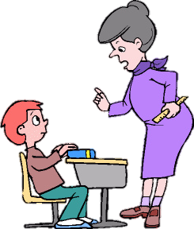

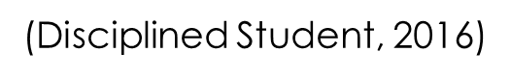
Rules Keep Students Disciplined
(Disciplined Student, 2016)
(Disciplined Student, 2016)

Slide 5
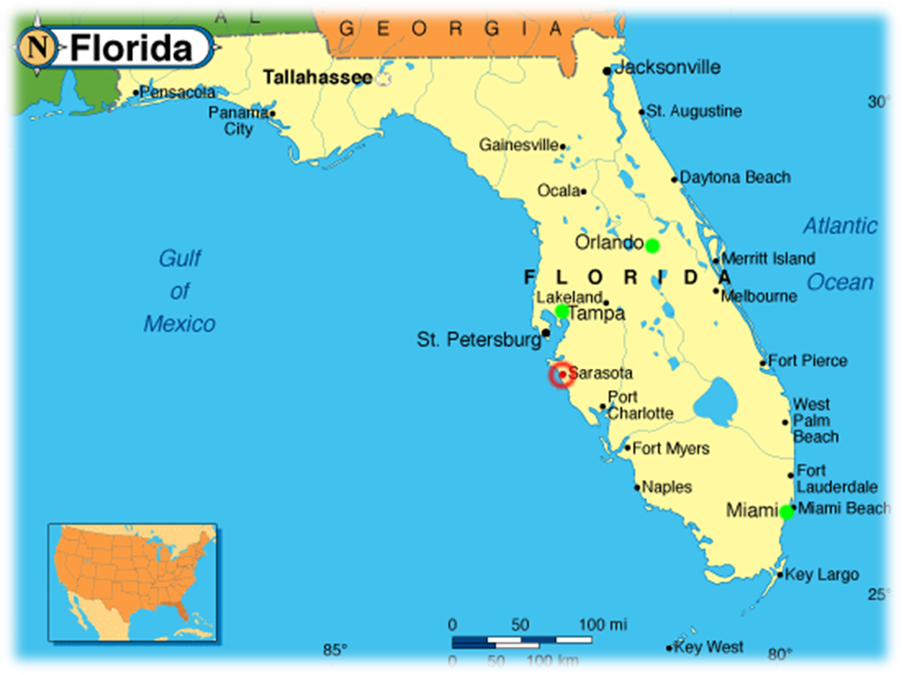
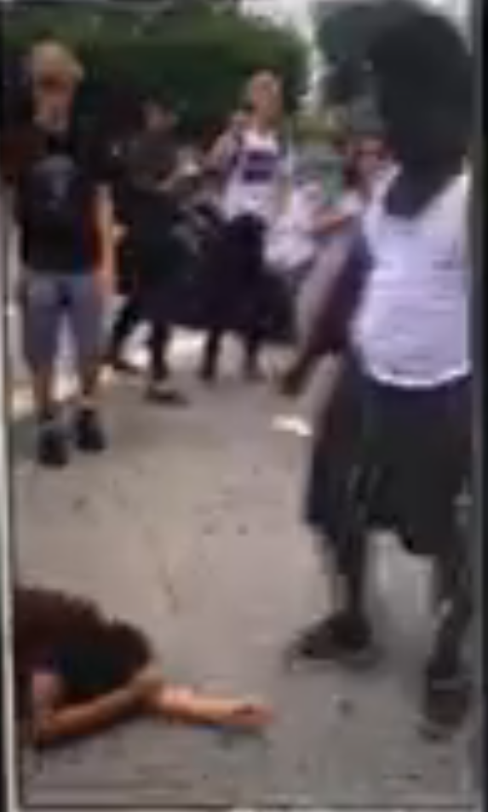
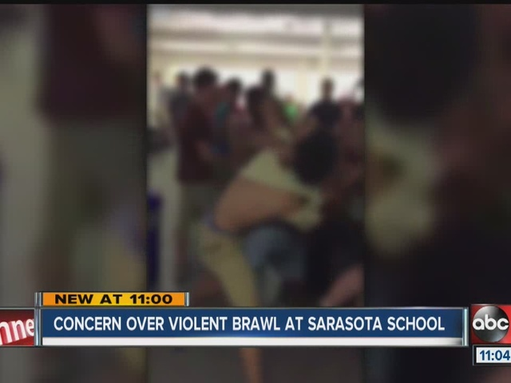
School Rules Are Necessary Local Examples:
(Sarasota High Fight, 2016)
(Sarasota High Fight, 2016)
(Sarasota High Fight, 2016)
(Sarasota Fl, 2016)

Slide 6
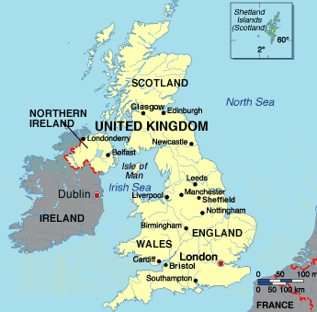



One Year Study
School Rules Are Necessary
(No phones in school, )
(Participating students, 2016)
(Ireland, 2016)

Slide 7
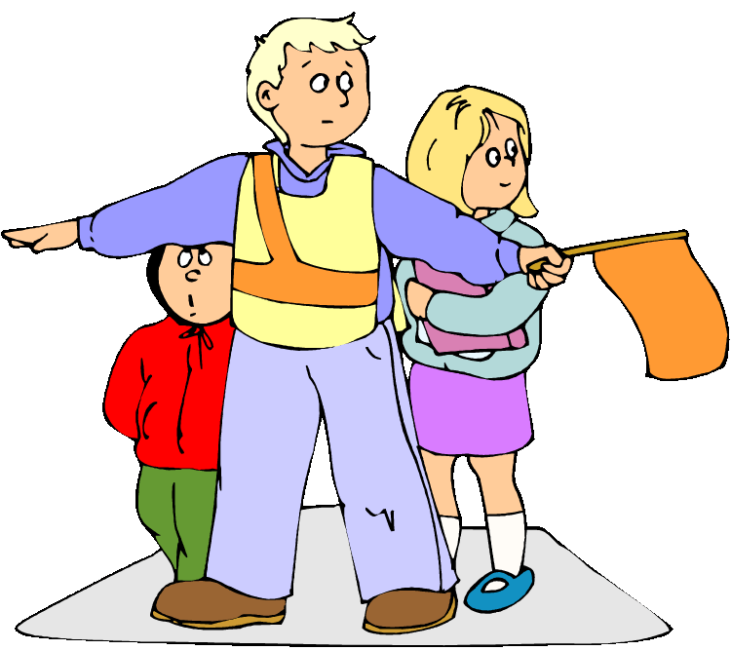
School Rules Keep Students Safe
(Safety of Students, 2016)

Slide 8
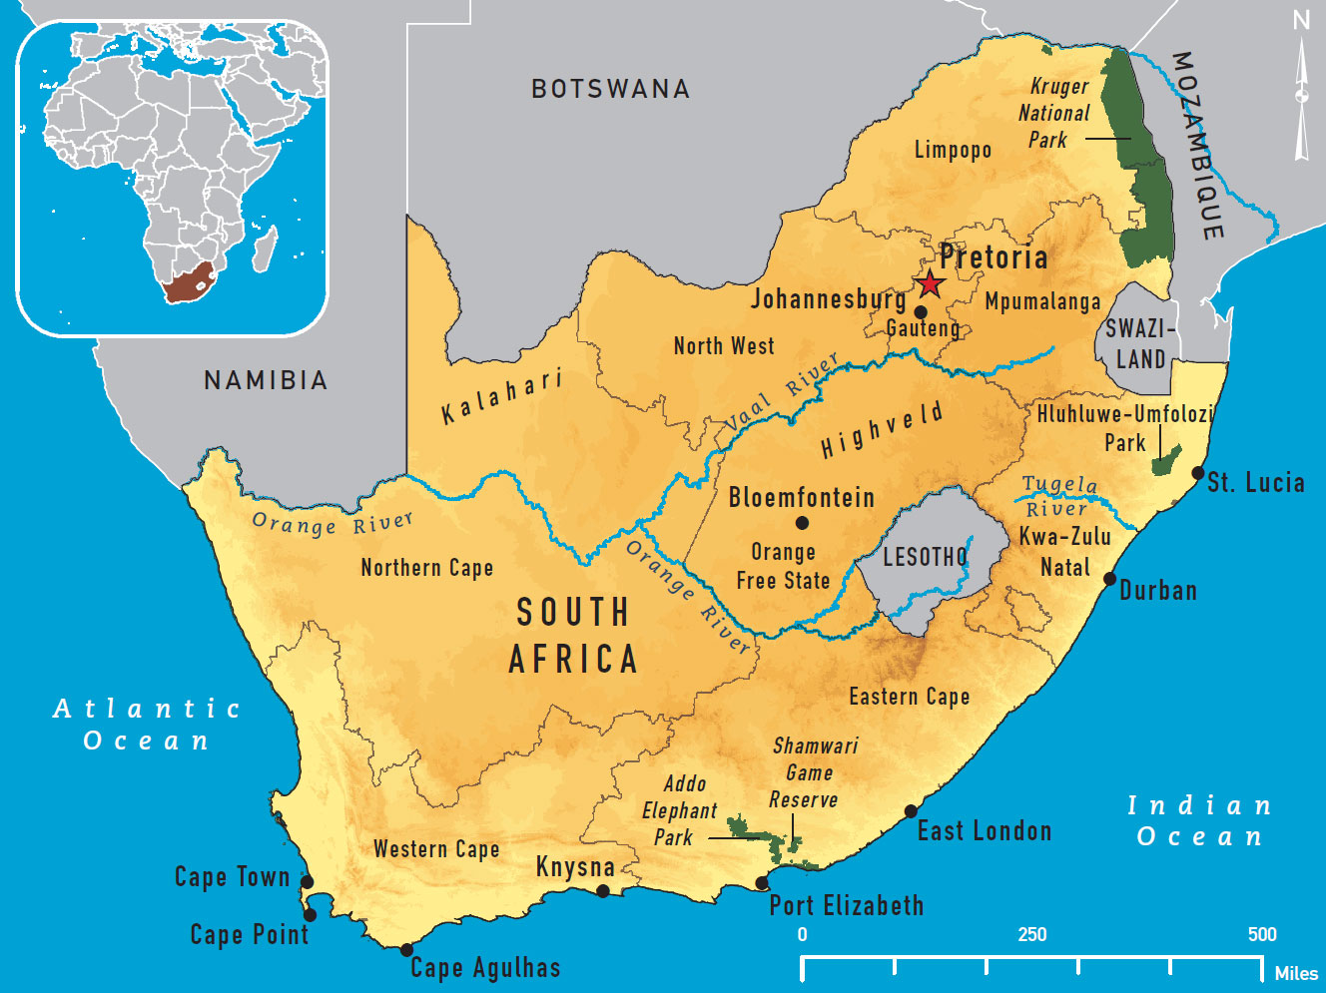
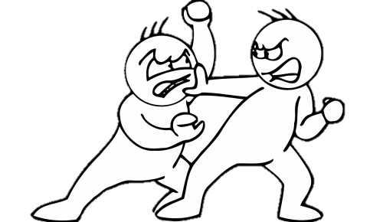

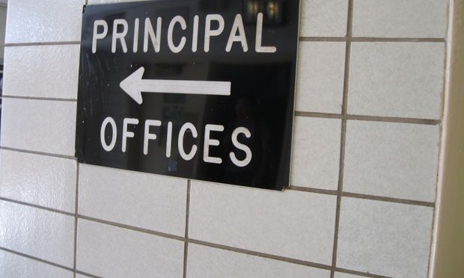
School Rules Are Necessary Good Kid Gone Bad
(School fights, 2016)
(Principles Office, 2016)
(South Africa, 2016)

Slide 9



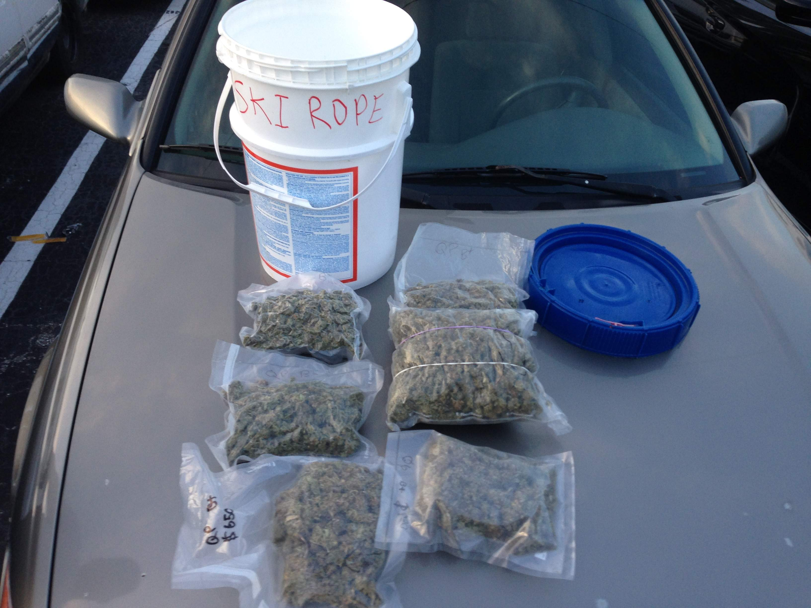
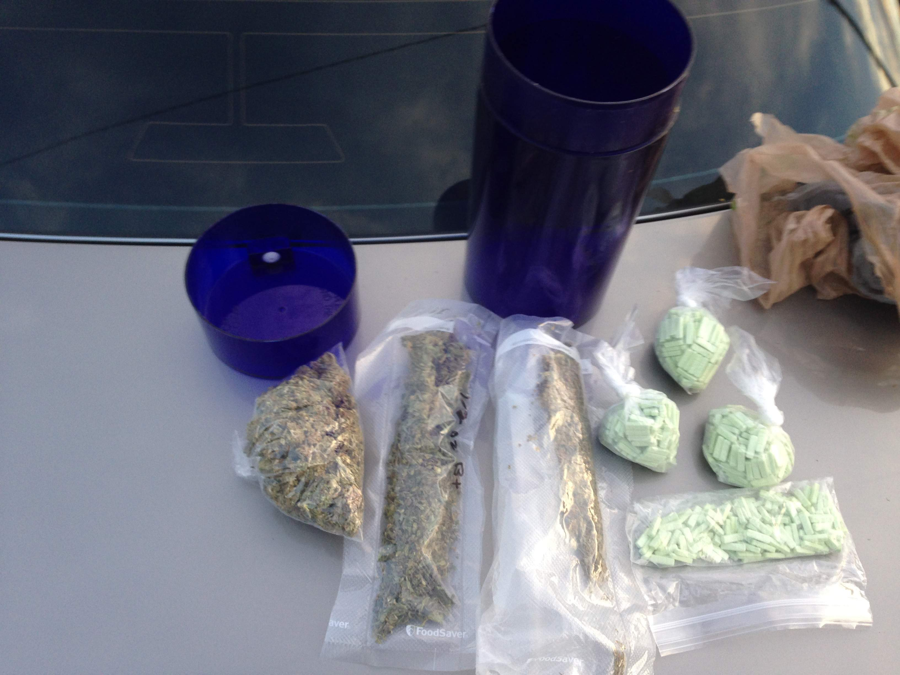
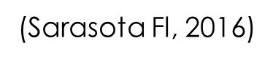
(Sarasota High Drugs, 2016)

Slide 10

Rules Teach Students to Silence Their Voices
(Silence your voice, 2016)

Slide 11

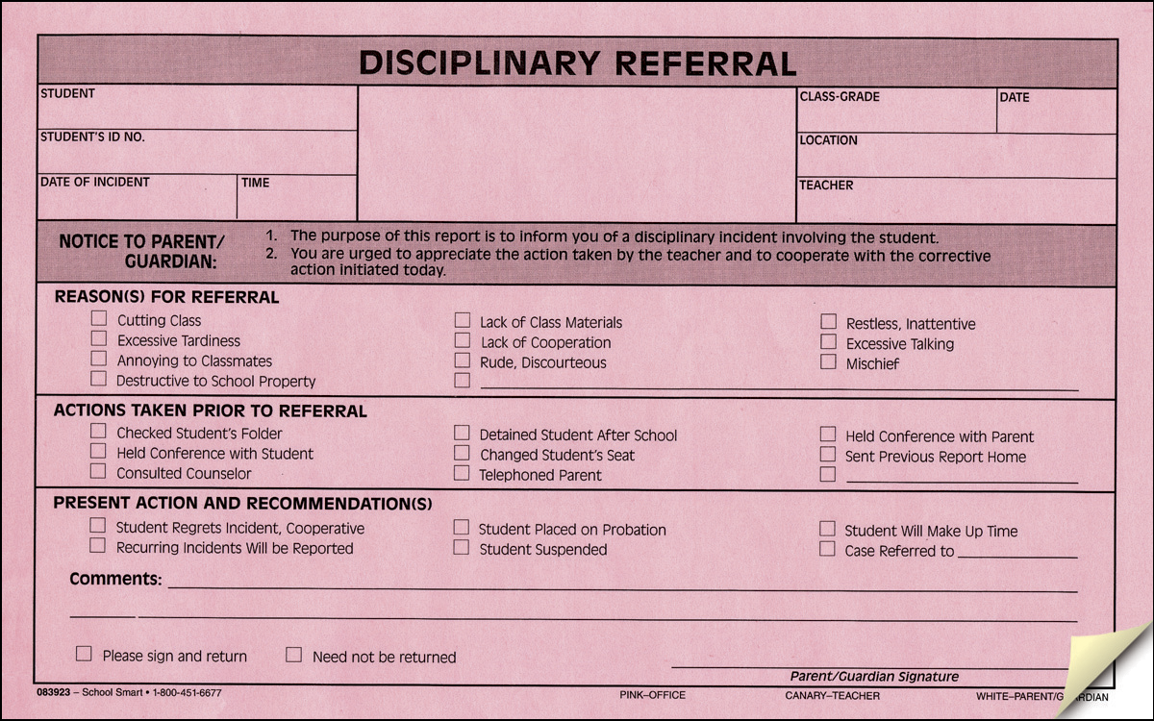
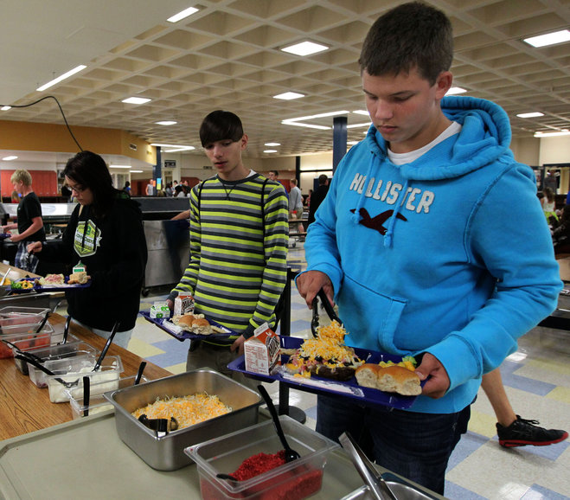
School Rules Are Unnecessary
(Referral, 2016)
(Student in lunch line, 2016)
(Sarasota Fl, 2016)

Slide 12
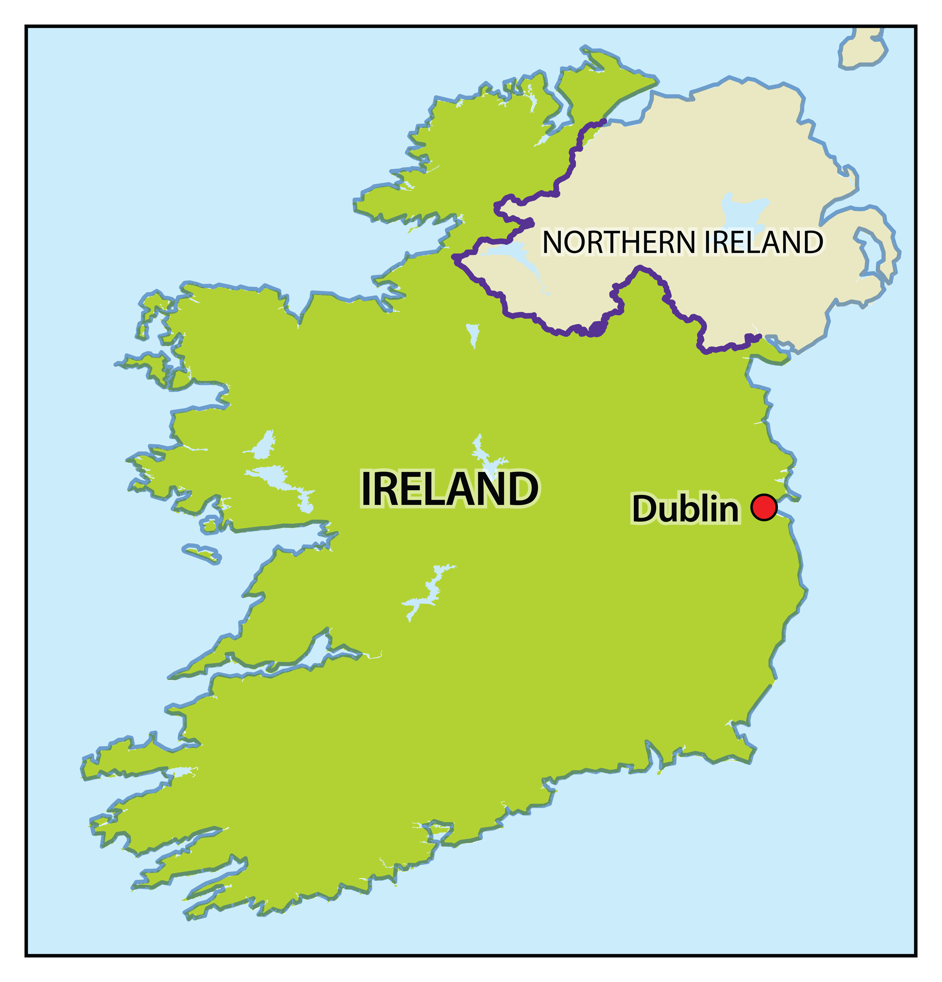
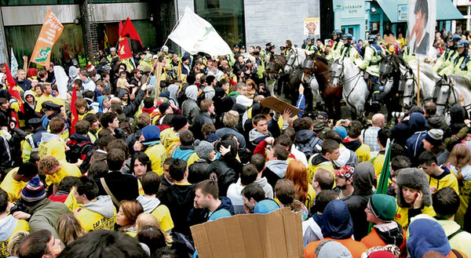


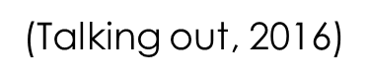
Student Protest
(Talking out, 2016)
(Ireland, 2016)

Slide 13
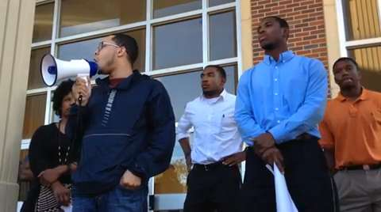
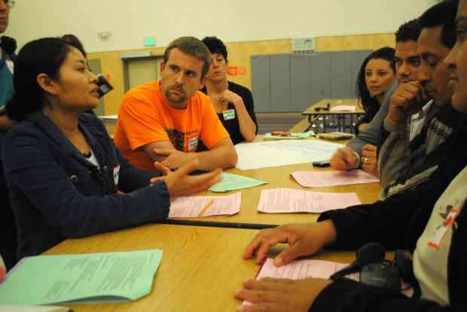

Solution
(Voice being heard, 2016)
(Teachers Discussing Rules, 2016)
(Students happy with teacher, 2016)

Slide 14

Reflection
(Thinking, 2016)

Slide 15
Conclusion

Slide 16
References
Doward, J. (2015, May 16). Schools that ban mobile phones see better academic results. Retrieved April 21, 2016, from http://www.theguardian.com/education/2015/may/16/
schools-mobile-phones-academic-results
J. B. (2015, February 25). Sarasota teen arrested on drug charges. Retrieved April 21, 2016, from http://www.mysuncoast.com/news/local/sarasota-teen-arrested-on-drug- charges/article_bdd27cde-bd2a-11e4-b165-739465986125.html
J. C. (2013, July 22). Students’ voices are not being heard. Retrieved April 20, 2016, from http://www.portadowntimes.co.uk/news/your-community/letters/students-voices-are-not- being-heard-1-5305196
R. B. (2009, Fall). Pushed Out. Retrieved April 19, 2016, from http://www.tolerance.org/pushed- out
Webb, S. (2015, May 14). Police used Taser on student during fight at Sarasota High. Retrieved April 21, 2016, from http://www.heraldtribune.com/article/20150514/article/150519830

